Slide 1
Environmental, Social, and Governance (ESG) and YOU!
How improving your company’s sustainability model can help your bottom line.

Slide 2
Table of Contents
Overview
Trend analysis
Deliverables
Problems to solve
Target audience
Vision
Project objective
Proposed solution
Team
Market trends
Process

Slide 3

Overview
Here at Group 2, we are building a machine learning module to help determine the impact of sustainability on company performance.

Slide 4
Problems to solve
How sustainable is your financial portfolio?
Is there a correlation between stock market performance and ESG ratings?
1
3
2
How does sustainability drive KPIs such as Stock value, brand image, and employee and customer retention?
4
Can we balance balance ESG and turn a high profit?

Slide 5
Project objective
Transform publicly available data from Marketbeat and Yahoo! Finance, into a database for analysis, build a machine learning module to evaluate performance, and draw predictions/conclusions.

Slide 6
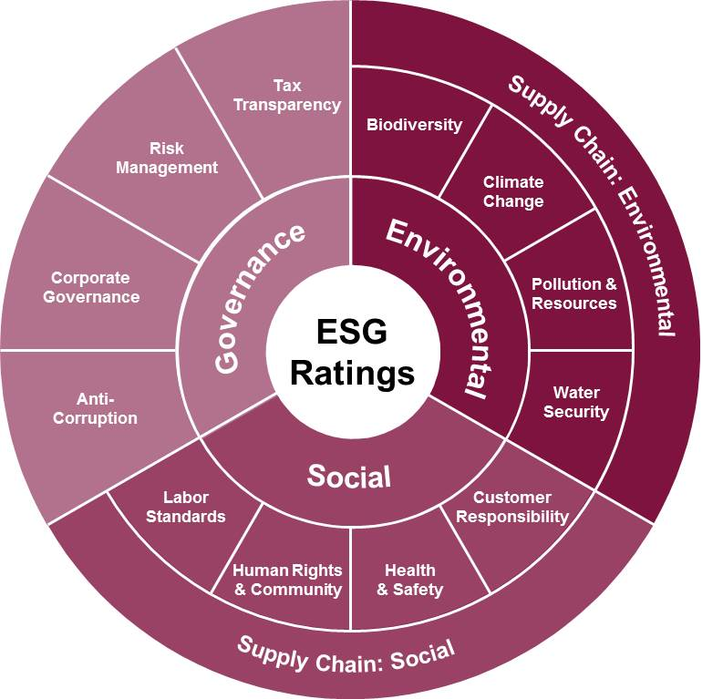
Target audience
Our presentation will be directed at business leaders who are looking to improve their company’s performance.
01 | Point 1 on outcome / results
02 | Point 2 on outcome / results
03 | Point 3 on outcome / results
04 | Point 4 on outcome / results
05 | Point 5 on outcome / results

Slide 7
Understanding the market

Slide 8
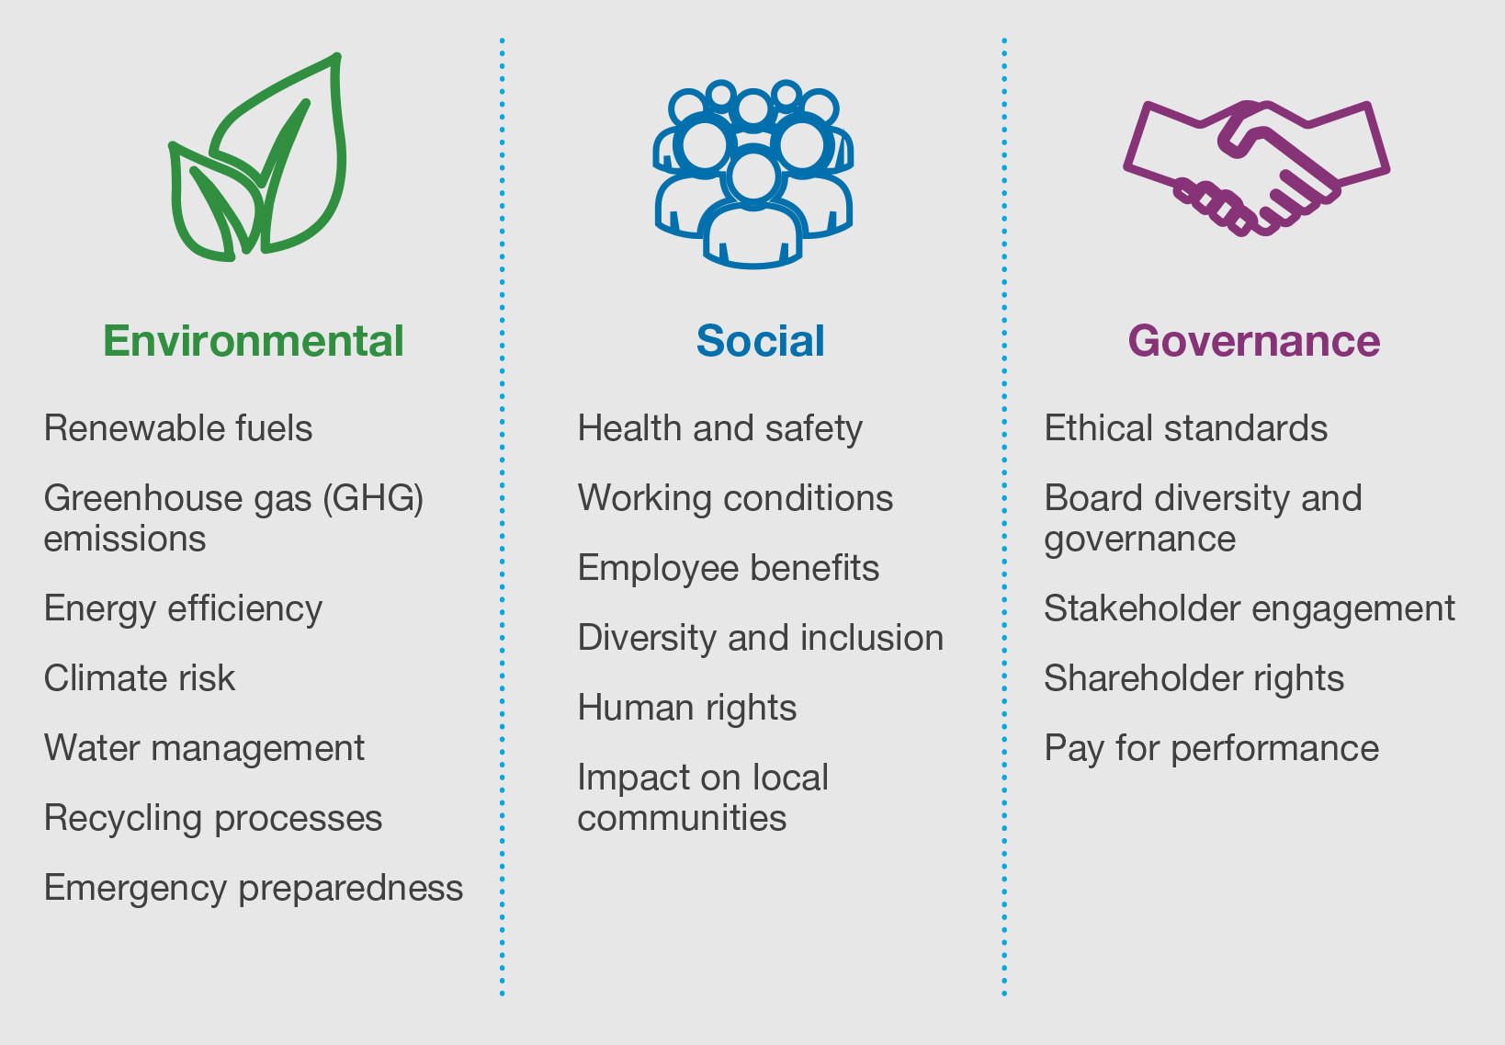
ESG trends
01
Environment (E): 56% of population lives in cities and towns and account for 70% of CO₂ emissions by 2050 70% will live in towns and cities. The global temperature will rise by 1.5◦ C if we have Net Zero Emissions of CO₂ by 2050 otherwise may be more than 3.5◦ C.
Client Implications:
TBD

Slide 9
ESG trends
02
Social (S): The global population is 8 billion set to rise to 8.5 billion by 2030 and 9.7 billion by 2050. Community Relations and Human Rights, Workplace Health and Safety, Diversity and Inclusion cannot be overlooked.
Client Implications:
TBD

Slide 10
ESG trends
03
Governance(G): With a population of more than 8.5 billion and global temperatures rising the need for innovation in Policy and Code of Conduct, Supply Chain Management, CSR initiatives is a must for any company.
Client Implications:
TBD

Slide 11
The Data Source
Our data was found on Marketbeat and Yahoo Finance.
MarketBeat: Sustainability parameters like environment, social, even public sentiment for various companies which have been rated highly based on their ESG initiatives.
Yahoo Finance: Five years of historical stock price data used to predict the stock prices using machine learning.

Slide 12
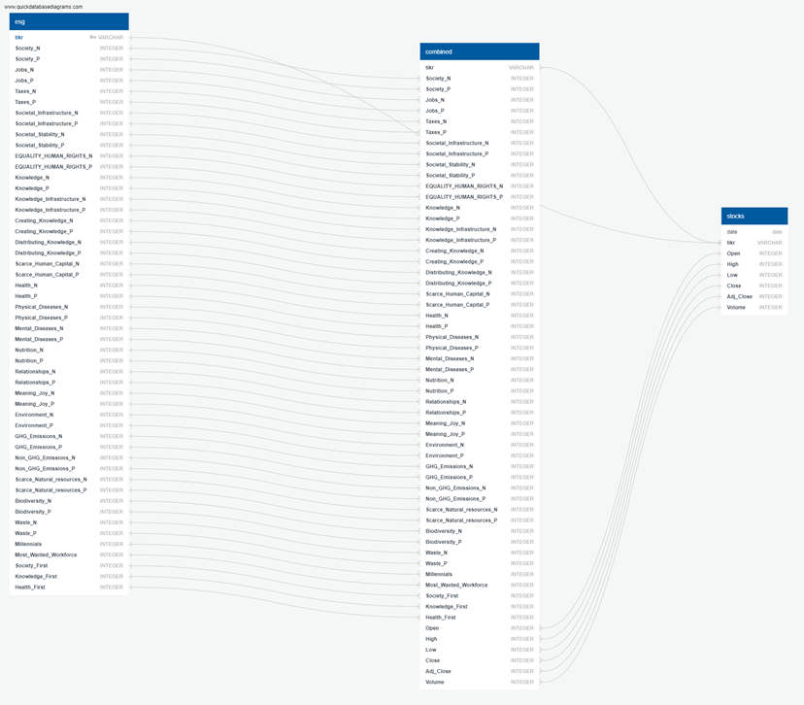
Database Framework
Info: Info on finalized ERDs when avail

Slide 13
Machine Learning
After reviewing various machine learning modules, Long short-term memory (LSTM), an artificial recurrent neural network (RNN) architecture, provided the best results.
LSTM is able to store past information which is important because previous price is crucial in predicting a stock’s future price.
Vanilla RNN suffer from vanishing gradient problem that making them unable to establish long term dependencies. LSTM overcomes that problem.

Slide 14
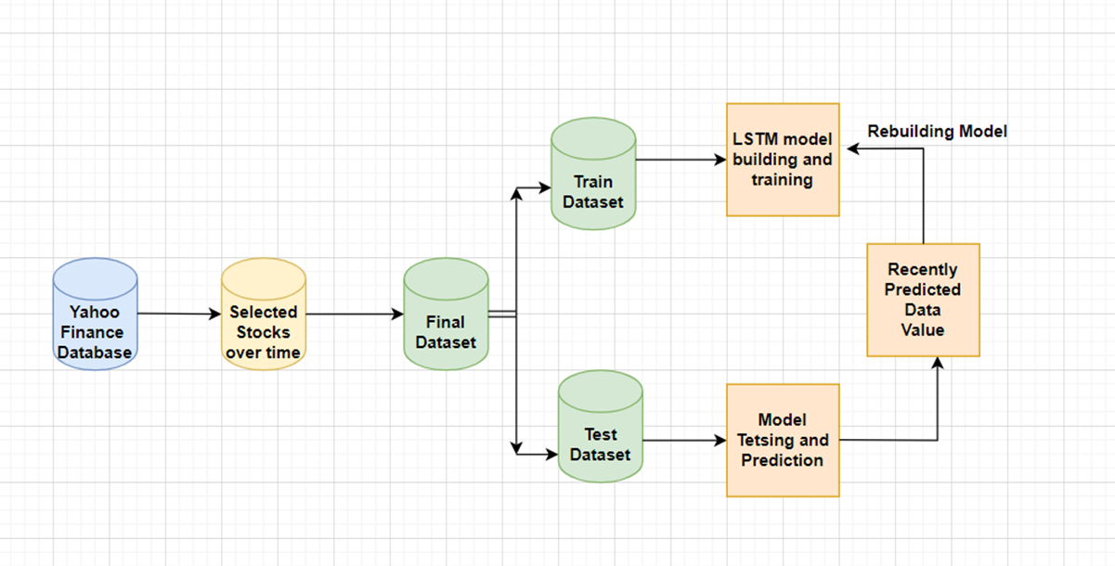
LSTM Flow Diagram
Info: Info on finalized ERDs when avail

Slide 15


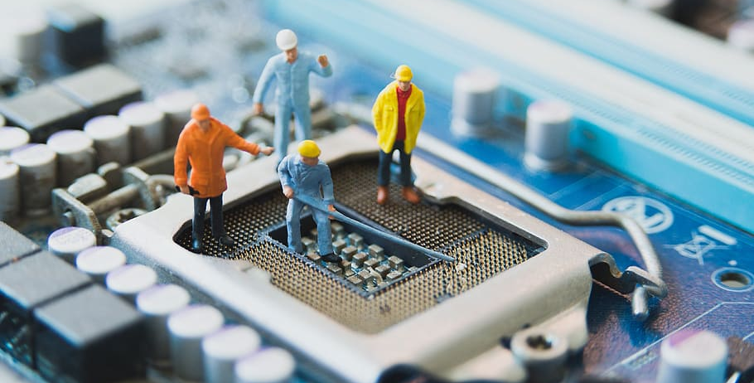
Data Exploration
Feature Engineering
Training & Test Sets
Data Preprocessing
01
Identify features for optimal performance.
Ensure proper encoders
03
02
Remove duplicate/null data.
Break data into smaller tables
Remove noisy data
Use test_train_split from sklearn to split data.
Scale data accordingly

Slide 16
Proposed solution
TBD - let’s see where machine learning takes us! :)

Slide 17
Trend analysis
Here’s a neat slide we can use to display some fun data!
100
80
60
40
20
0
Jan
Feb
Mar
Apr
May
Jun
Jul
Aug
Sep
Oct
Nov
Dec
Trend 01
Trend 02

Slide 18
Here we can include more details on our findings
Trend 01
75%
Trend 01 notes
Trend 02
53%
Trend 02 notes

Slide 19
Deliverables
To be updated once our questions have been asked.
Metric 1
Metric 2
Metric 3
45K
690K
100K
Details on metric 1
Details on metric 1
Details on metric 1

Slide 20
Vision
Milestone 1
Milestone 3
Milestone 5
Milestone 2
Milestone 4
Details on Milestone 1
Details on Milestone 3
Details on Milestone 5
20XX
20XX
20XX
20XX
20XX
Details on Milestone 2
Details on Milestone 4

Slide 21
Thank you.

